Slide 1

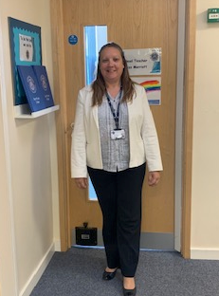


Welcome
Miss J Marriott
Headteacher

Slide 2







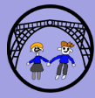
Challenge | Honesty | Ownership | Courage | Collaboration
Push ourselves and have confidence Work hard Don’t give up Be a creative and independent thinker | Always do the right thing Act honestly Do what is right over what is easy Treat everyone with respect Respect our differences | Take responsibility for your actions Go the extra mile Take responsibility in all areas of school Care about the wellbeing of yourself and others Be positive | Be determined to deliver greatness Be brave Be determined Try hard everyday Have confidence | Work together to succeed Work together Listen to others Respect the opinions of others Participate in all activities Be proud of our diverse, British society.
William Reynolds Rainbow

Slide 3
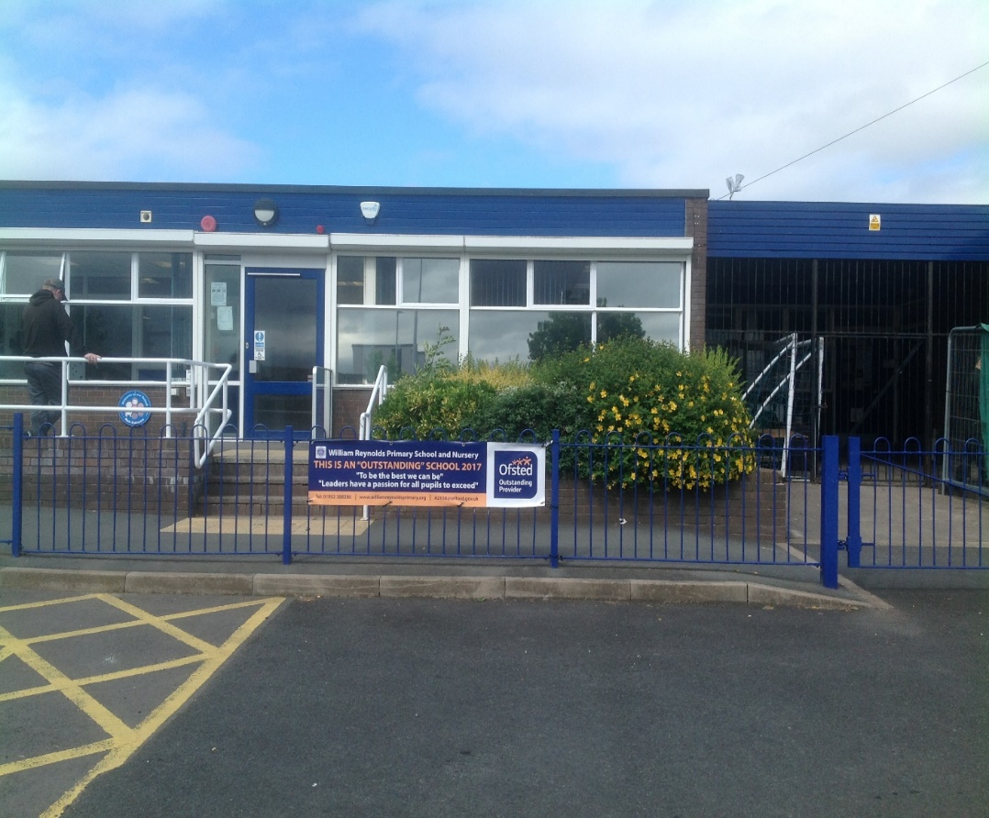
William Reynolds Primary School and Nursery
Foundation Stage
Pupils in Nursery and Reception work together in the Foundation Stage Unit.
At William Reynolds Primary School and Nursery the four EYFS key themes and commitments.
A Unique Child
Positive Relationships
Enabling Environments
Learning and Development
are central to us creating a Foundation Stage that starts with the child, supports and develops the role of parents, offers a high quality environment and provides children with exciting contexts for their learning. We believe in encouraging children to be curious, to play and explore, actively engage in their learning and develop skills of creativity and critical thinking.
There is a balance between child and adult led experiences. Teachers plan experiences within meaningful contexts for learning both inside the classroom and outdoors.

Slide 4
Timings for school day
8.35a.m. | Doors are opened by SLT for the children to be welcomed into the school and complete morning activities
8.45 a.m. | Register is called and then sent to the school office
8.45 a.m. | Outer doors are closed – any late arrivals must come through the main reception door and sign in
9.00 a.m. | Phonics - RWI
9.30 a.m. | Understanding the World
9.50 a.m. | Child Led – Reception and Nursery
10.50 a.m. | Snack - fruit and water
11.10 a.m. | Understanding the World and Handwriting
12.00 p.m. | Lunchtime
1.00 p.m. | Register is called and then sent to the school office
1.05 p.m. | Maths
1.50 p.m. | Child Led – Reception and Nursery
2.55 p.m. | Story, Rhymes and Poetry
3.15 p.m. | End of the school day. Children are shown out of their classroom by teachers to ensure their safety

Slide 5
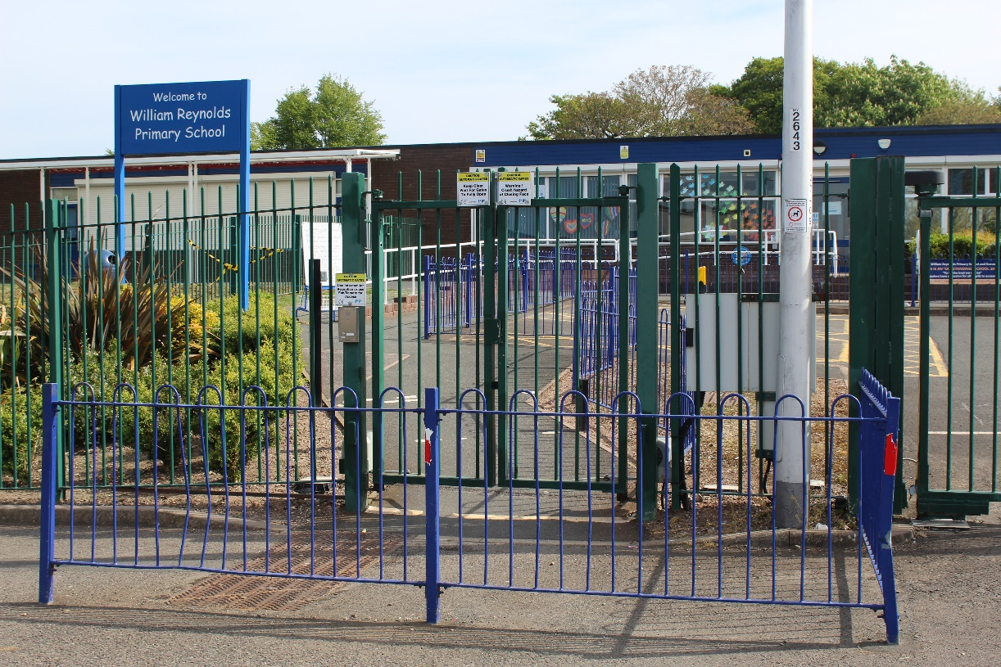
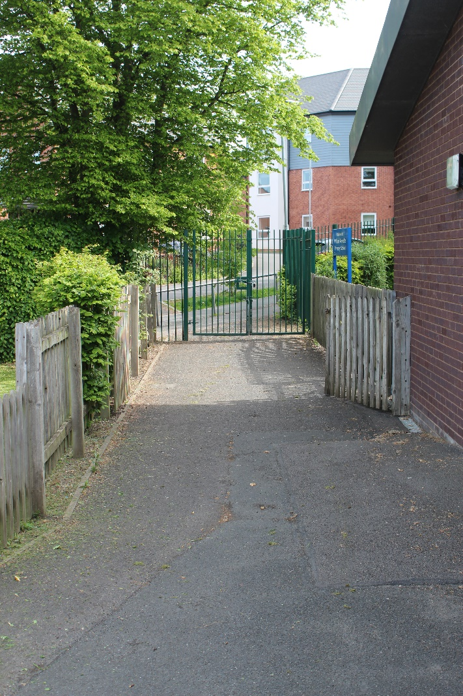
Entrances and Exits in and out of school

Slide 6
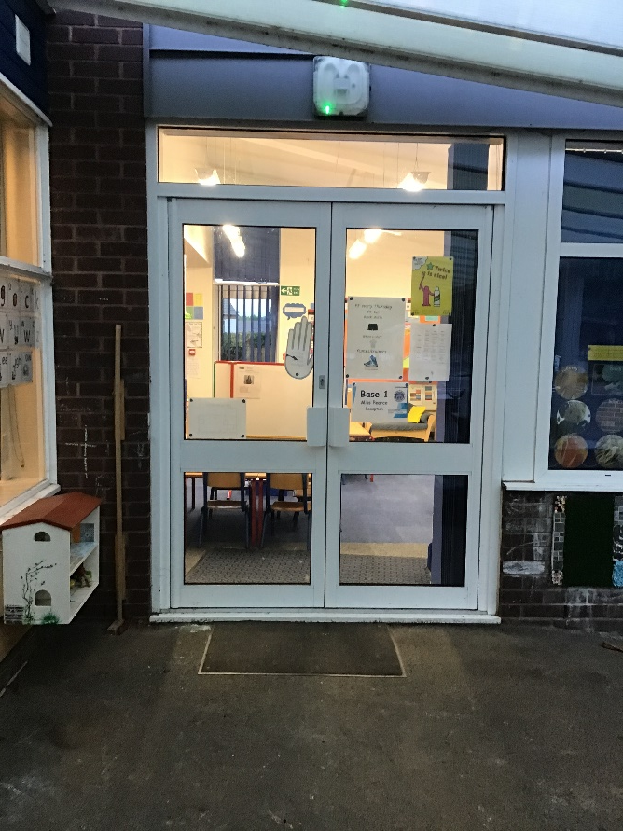
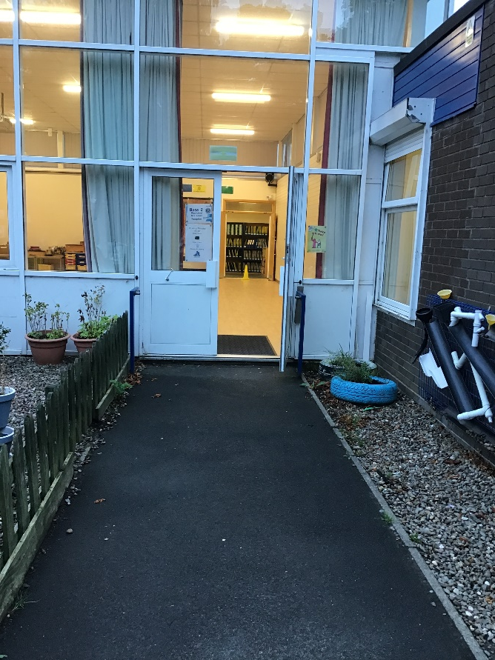
This is the door where Reception go in.
Base 1 Base 2

Slide 7
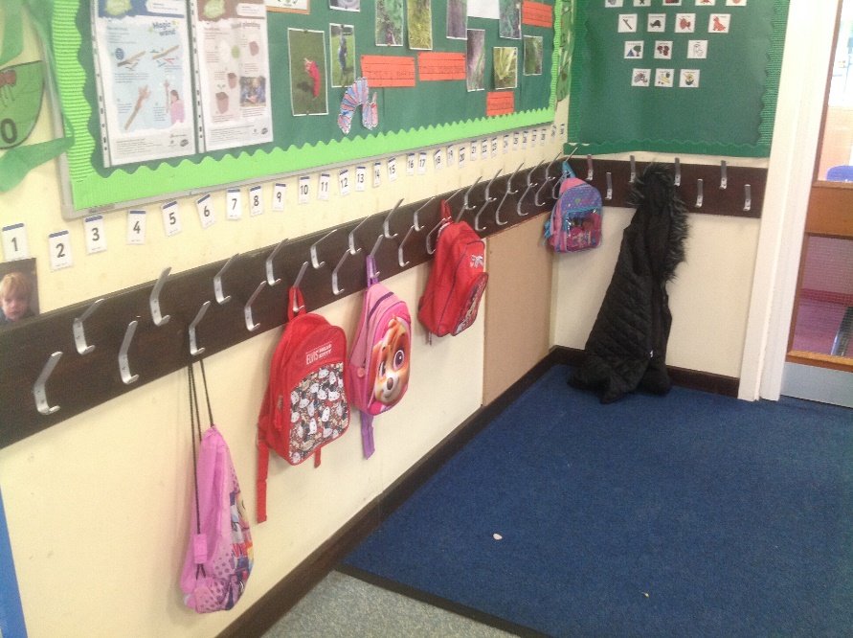
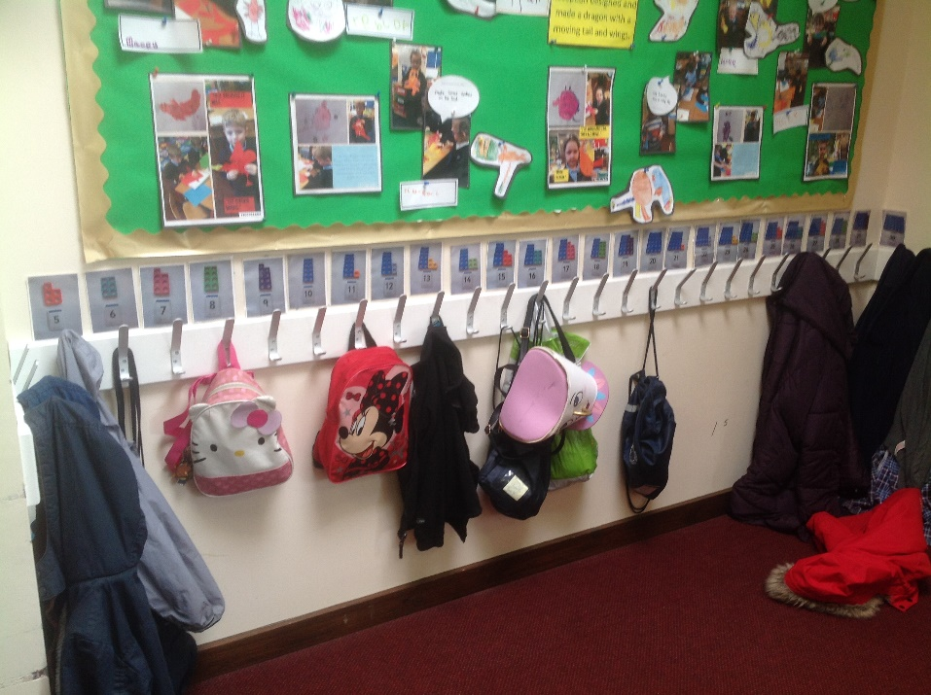
This is where Reception hang up their coats.

Slide 8
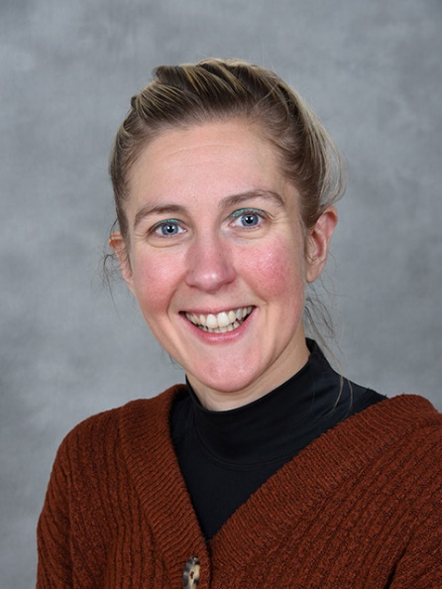
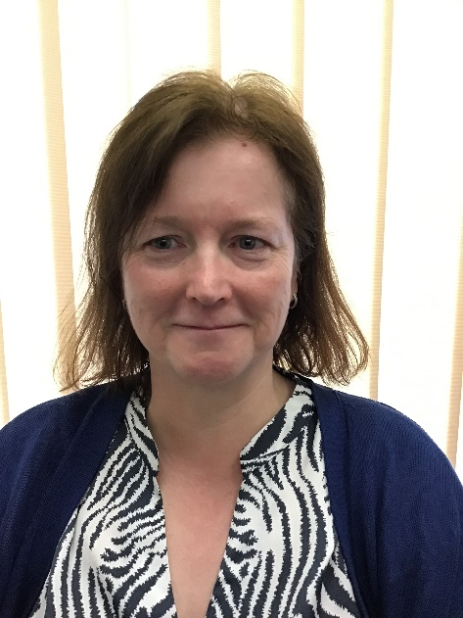
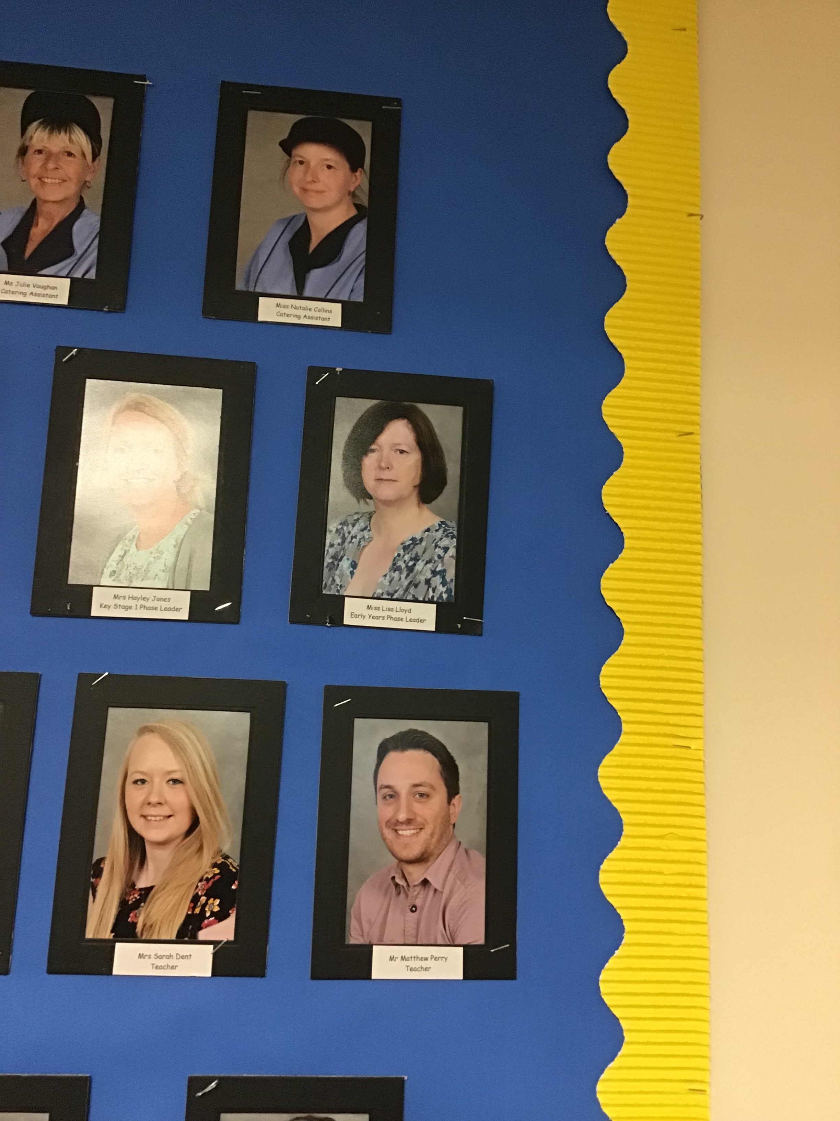
These are the Reception teachers
Miss Lloyd
Early Years phase Leader
Mrs Dent
Mrs Jones

Slide 9
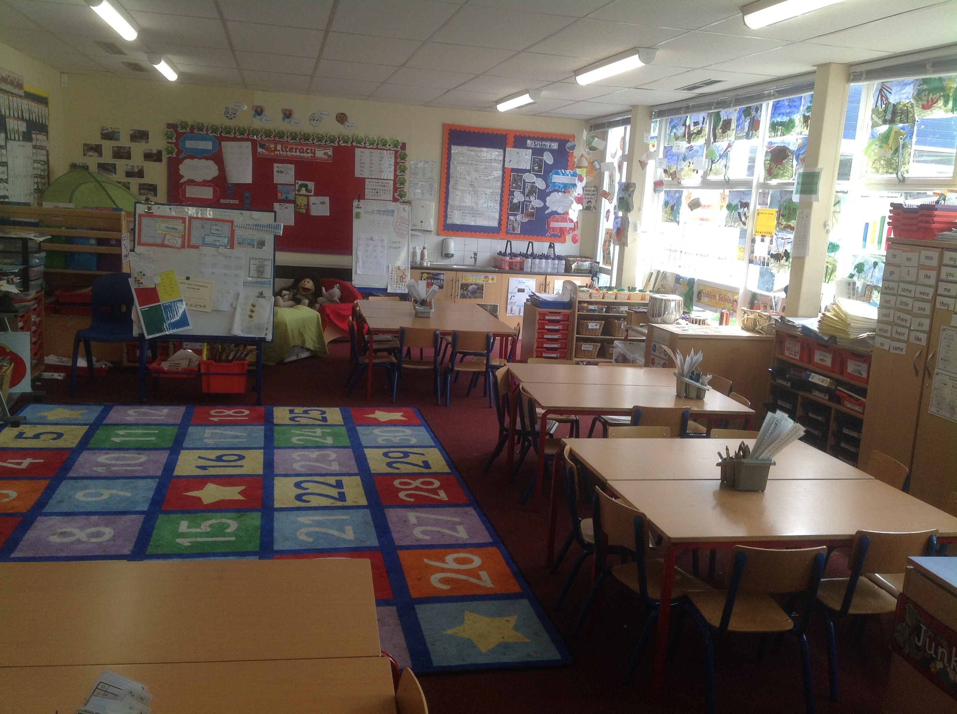
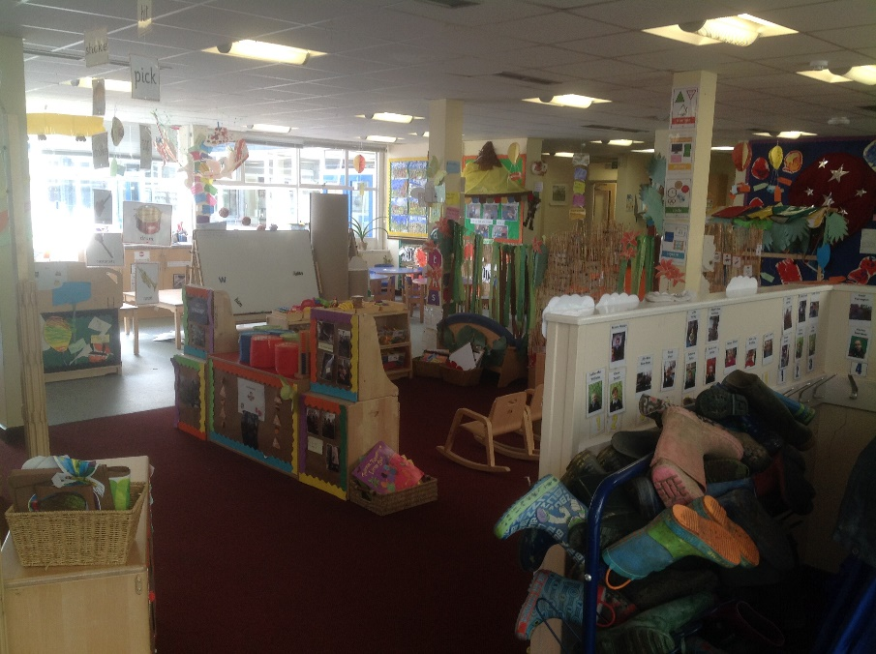
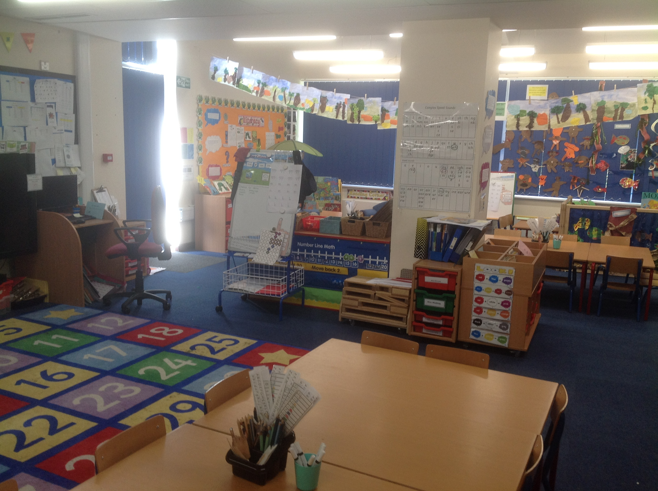
These are the Reception and Nursery classrooms.

Slide 10
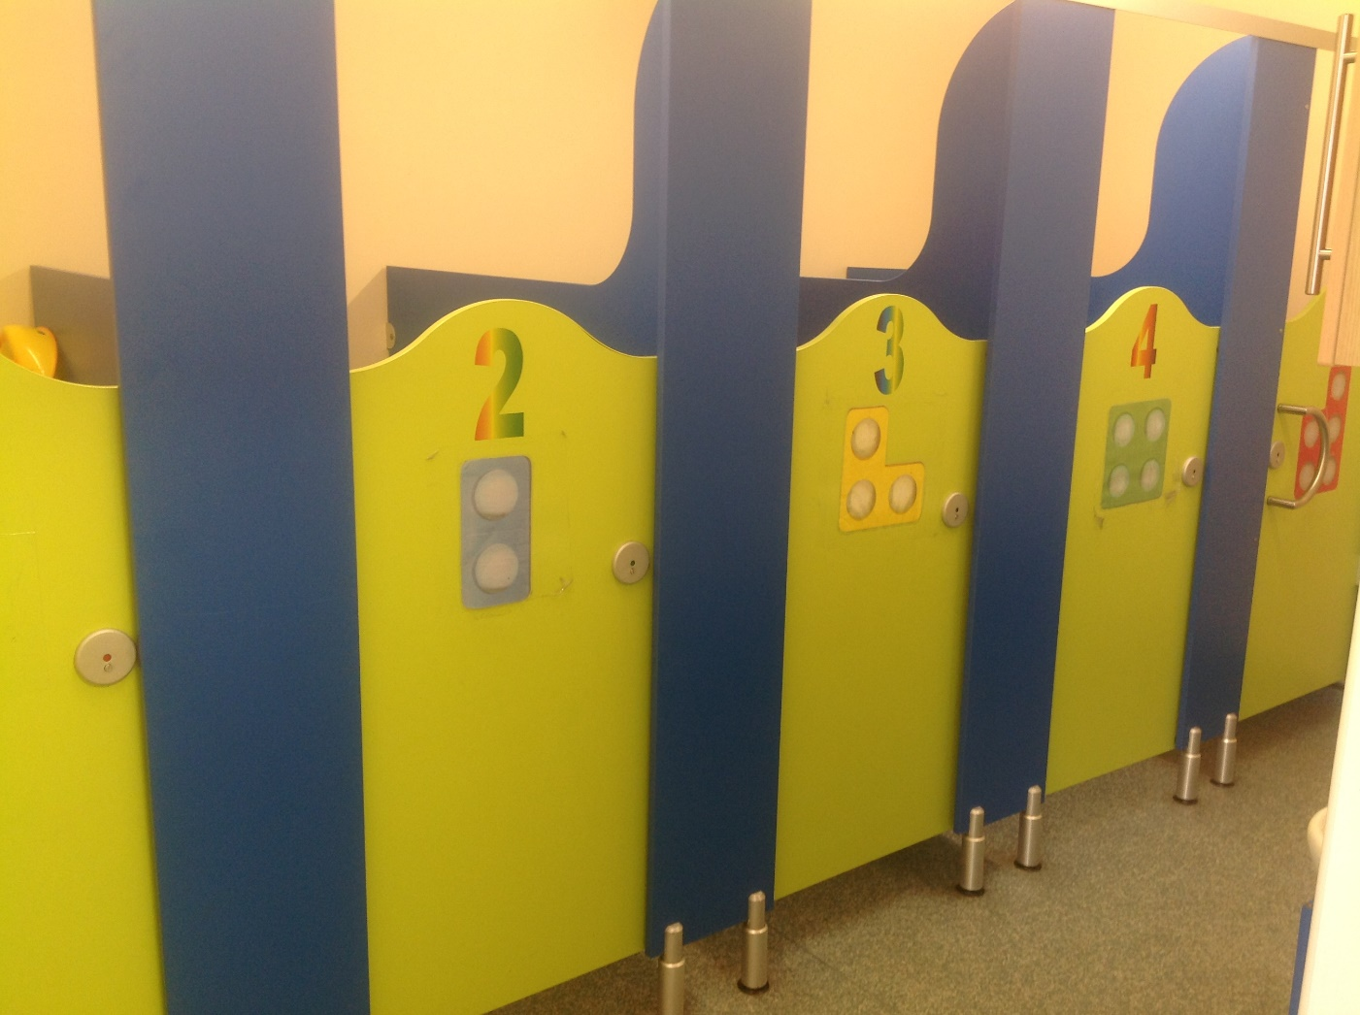
These are the Early Years toilets.

Slide 11
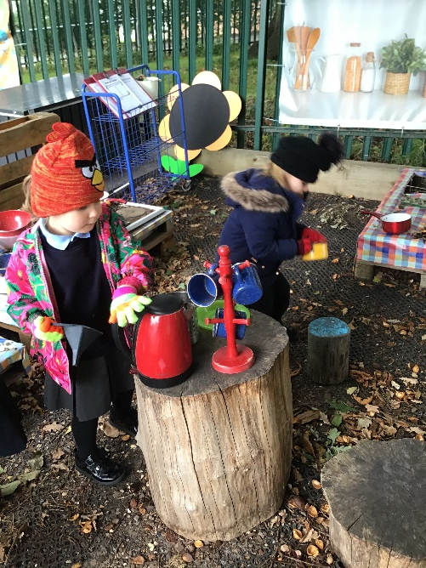
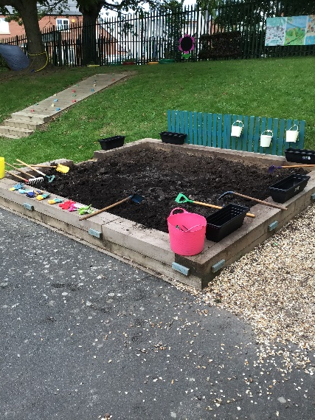
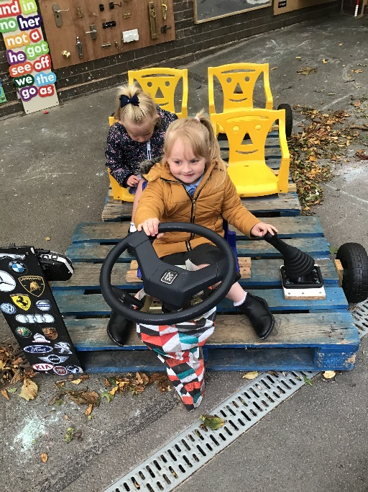
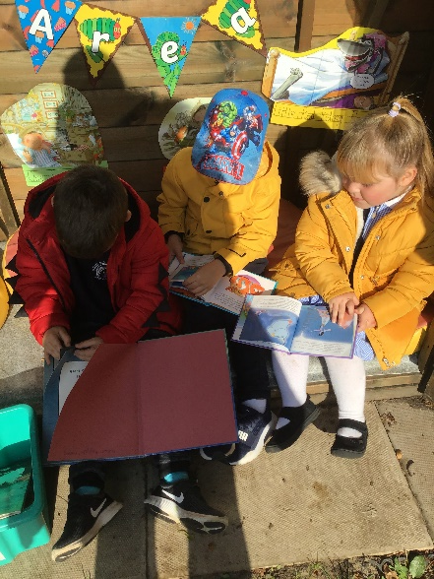
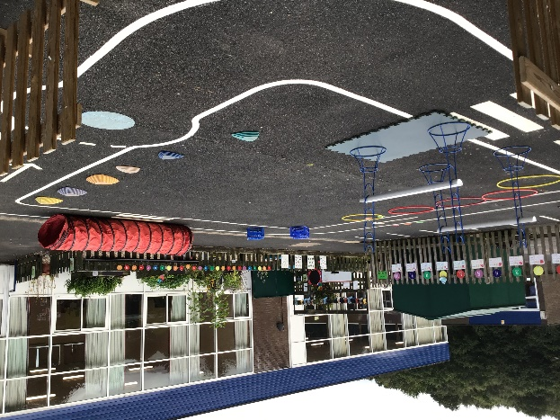
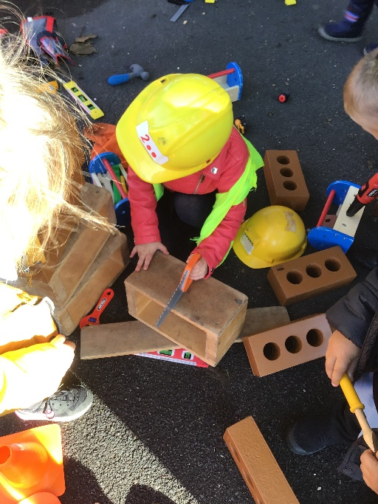
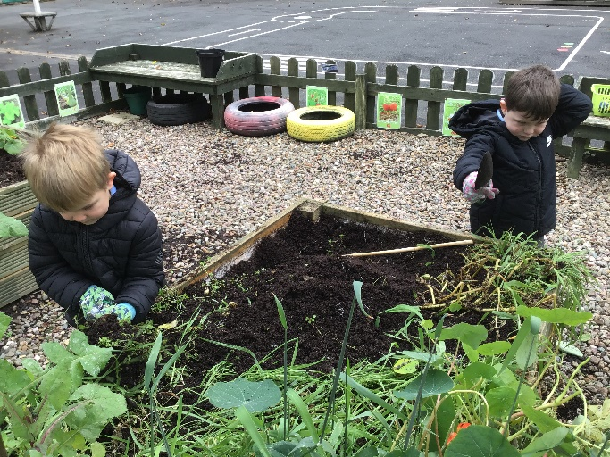
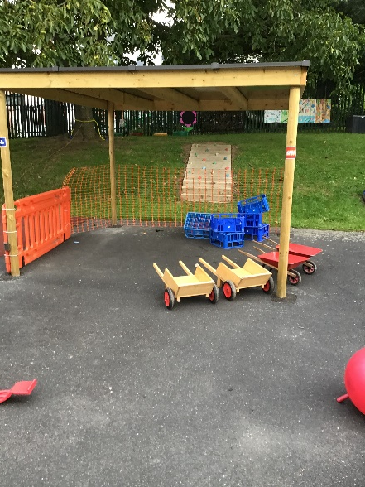
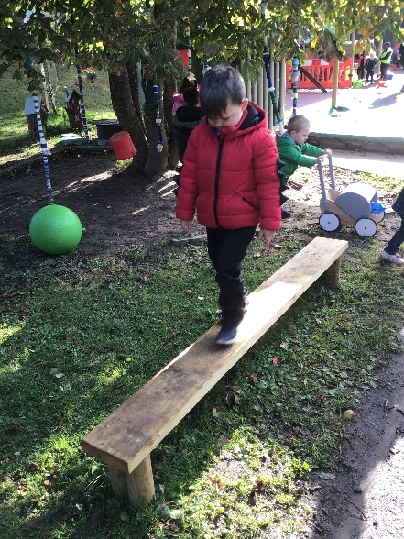
This is the Early Years outdoor area.

Slide 12
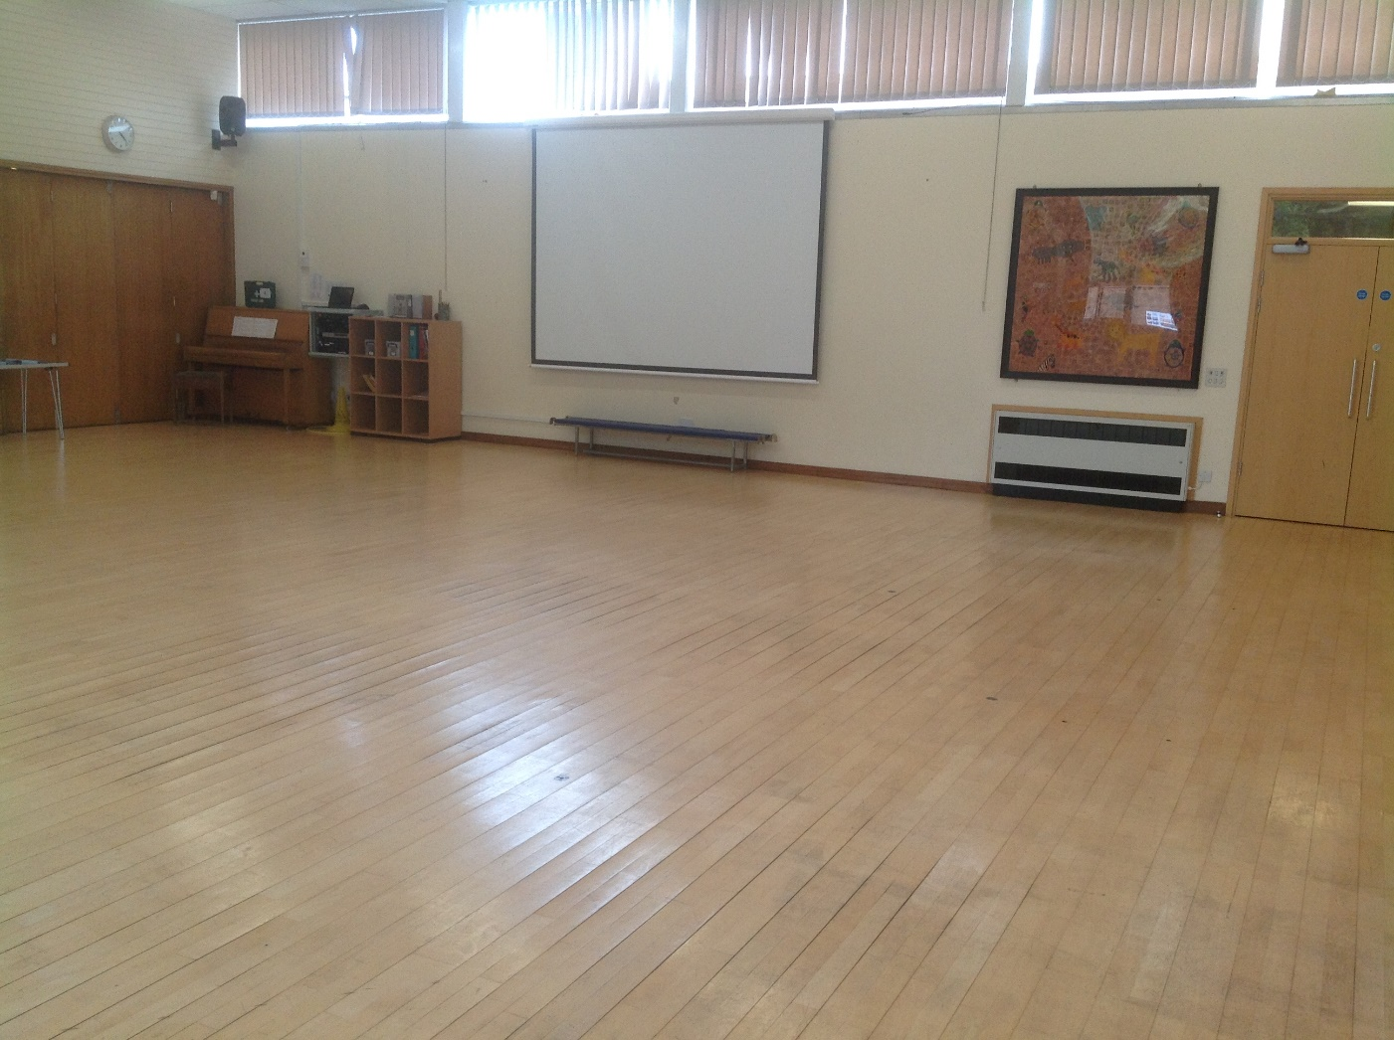
This is the hall where Reception will do PE.

Slide 13
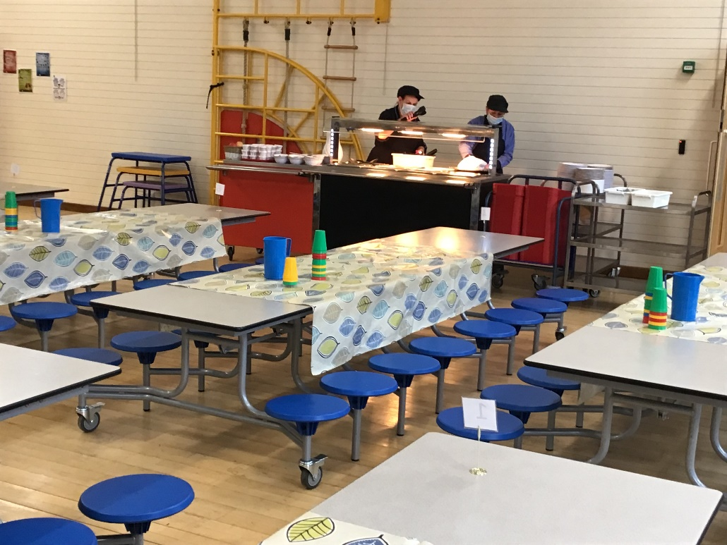

This is the hall where Reception will have lunch.
Universal Free SCHOOL Meals Years Reception to Year 2
If your children are in reception, year 1 or year 2 are entitled to a Universal Free School Meal. You will be required to complete a form on your entry to school as registering could raise extra funds for the school, to fund valuable support like extra tuition, additional teaching or school activities. From year 3 to 6 you need to apply separately for Free School Meals, so please use the link below for further information.
Free School Meals
To find out if you are eligible and to apply for free school meals, visit Telford & Wrekin’s free school meals page.
Sandwiches and Packed Lunches
Children are welcome to bring packed lunches to school if they prefer that to school meals. They are eaten in the school hall alongside the children with school meals.

Slide 14
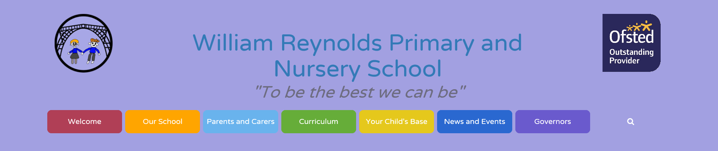


Class Pages on the Website http://williamreynoldsprimary.org/
Click on Your ‘Child’s Base’
Then click on Reception
Then click on your child’s base
You can find out:
What your child is learning each term, Important dates, Photo’s of educational visits and Photo’s of children’s learning

Slide 15
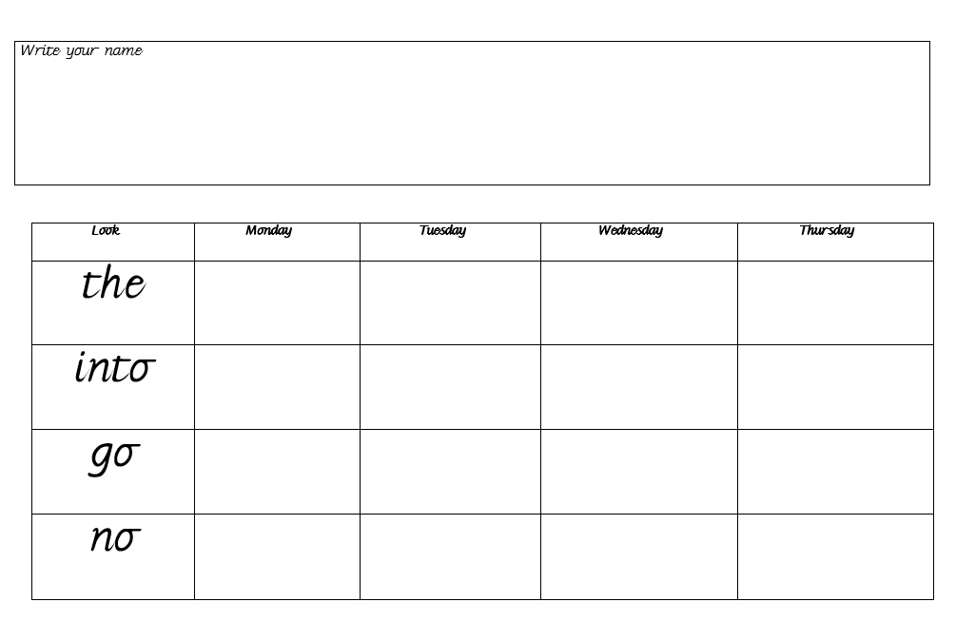
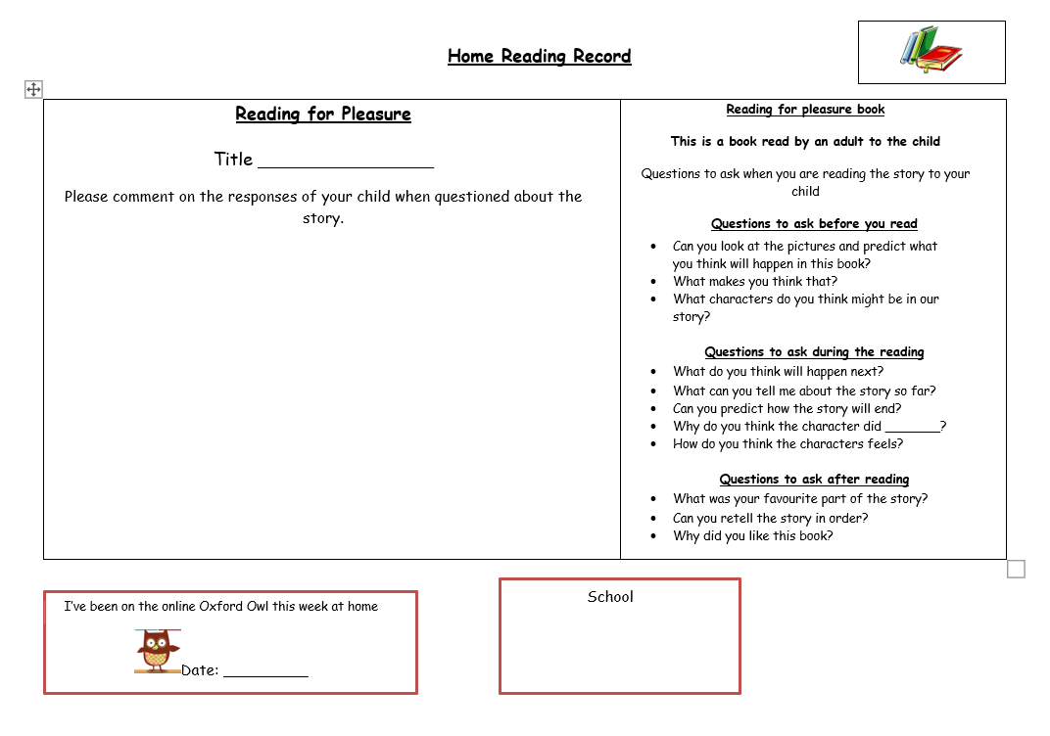

Homework
Children in Reception are given a free book bag to bring to school each day. The Home/School diary goes home each night in the book bag. The diary contains information about P.E. and Forest School kit and targets for Literacy, Mathematics and Science. Homework is given out on a Monday and collected in on a Friday in a homework book. Pleasure for reading books are changed every Monday. RWI reading books are changed weekly to begin with and then every three days. Parents need to fill in the section parent comment on the reading record each week.

Slide 16



Websites
Inside the front cover of the homework books are passwords to access
Oxford Owl, Numbots and Purple mash at home to support your child’s learning at school.
Oxford Owl
e books to read
Numbots
Maths and literacy activities

Slide 17
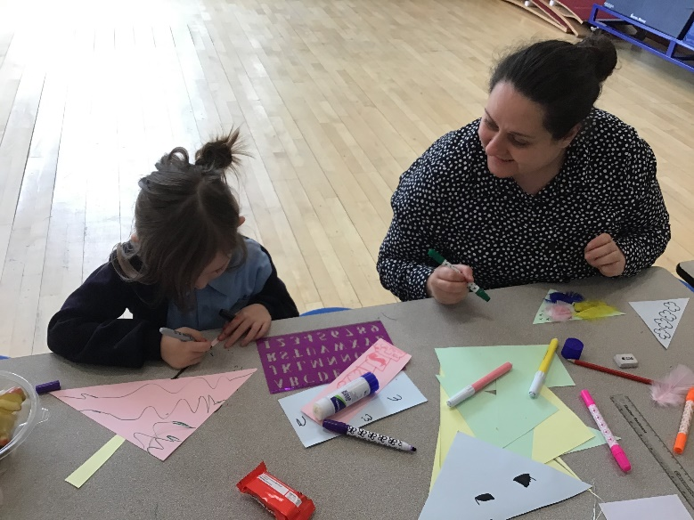
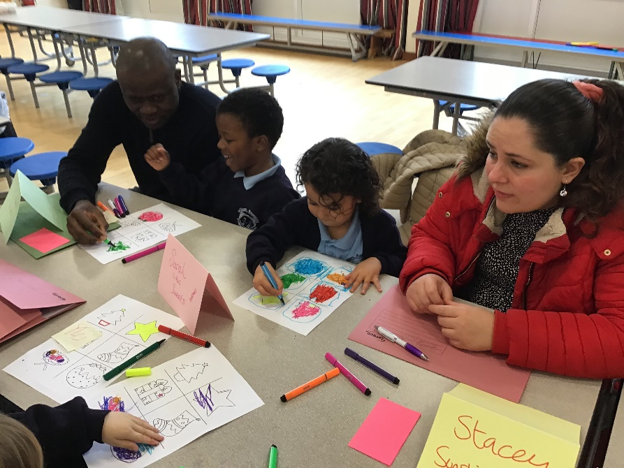
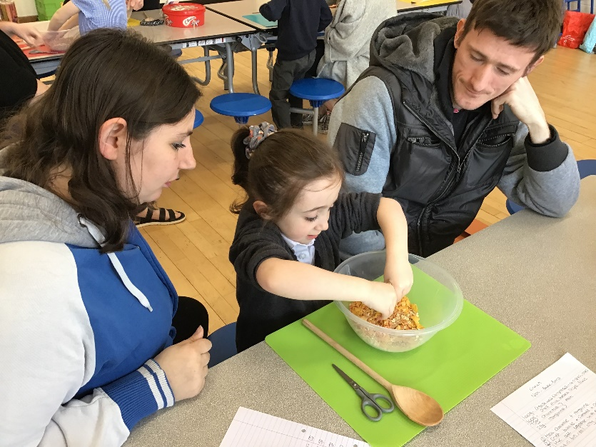
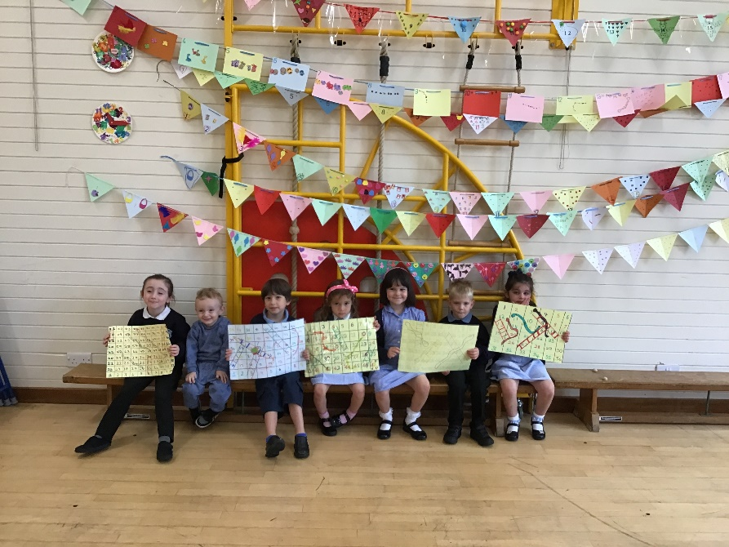
Friday Family Learning
For parents and their child in EYFS
Learn fun and innovative techniques and activities that help support and
promote your child's love of learning
Understand the importance of how children learn through play activities
ALL materials provided FREE!

Slide 18

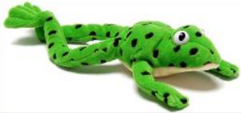
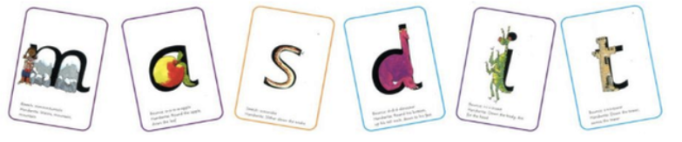
We use the RWI phonic programme to teach children to read, write and spell.
What is RWI?
Read Write Inc (RWI) is a phonics programme which helps all children learn to read fluently and at speed so they can focus on developing their skills in comprehension, vocabulary, and spelling.
In Reception all children will learn how to ‘read’ the sounds in words and how those sounds can be written down. Those who are ready, will begin to read simple words within books and write some of these.
Fred Talk
We use pure sounds (‘m’ not’ muh’,’s’ not ‘suh’, etc.) so that your child will be able to blend the sounds into words more easily. Fred is our Read, Write Inc. friend. He can only speak in sounds, so we help him learn to say words instead of sounds. For example, Fred says 'm-a-t' instead of mat. We also teach him not to add 'uh' to our sounds to keep them pure. For example, we say 'c' and not 'cuh’.
Talking
Children are assessed so they work alongside children at the same level. This allows them to fully participate in all lessons.
They work in pairs so that they:
answer every question
practise every activity with their partner
take turns in talking to each other

Slide 19
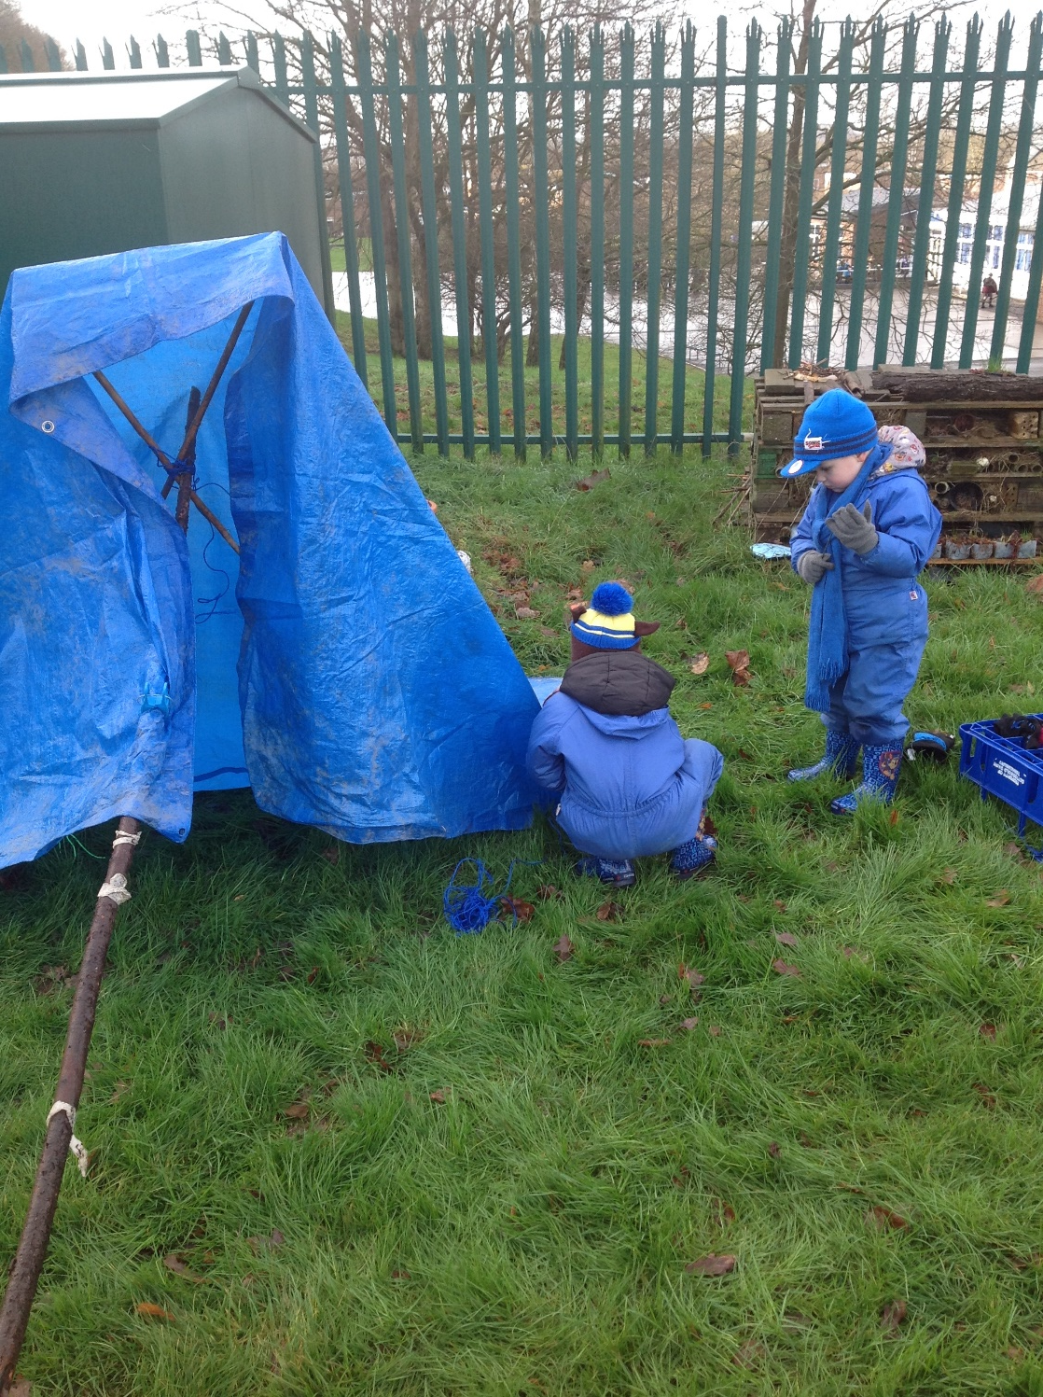
Forest School
Forest School is an innovative educational approach to outdoor play and learning. The philosophy of Forest School is to encourage and inspire individuals of any age through positive outdoor experiences. We currently run Forest School sessions in the Foundation Stage led by a suitably trained member of staff. An area within the school grounds has been developed as our Forest School area.
Children have the opportunity to learn about the natural environment, how to handle risks and most importantly to use their own initiative to solve problems and co-operate with others.

Slide 20

Our School Uniform
We have a school uniform at William Reynolds Primary School and Nursery. We believe this gives the child a real sense of belonging to a community and a sense of pride in their school.
We expect children to be clean and tidy and we have a practical, hard-wearing uniform.
The basis of our uniform is;
a dark blue sweatshirt or cardigan
a pale blue polo shirt
black or grey trousers, shorts, skirts or pinafore
blue checked or striped dresses
black shoes
Shoes with high heels and shoes without backs or thin soles are not safe for the children to wear in school.
Our school uniform is supplied by Brigade Clothing.
Email: sales@brigade.uk.com
Tel: 024 7642 1083

Slide 21

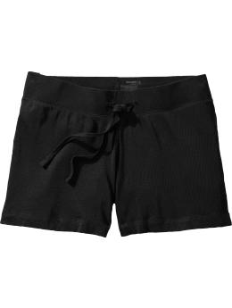
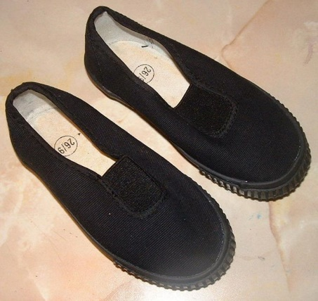
PE Kit
Pupils need to wear a plain white t-shirt and black shorts with trainers or pumps as a change of footwear for P.E. A plain sweat shirt and leggings or jogging pants can be worn for outdoor PE when the weather is cold.
All items of uniform must have your child’s name clearly written on the label. This ensures that lost items can be returned to the correct owner.
Jewellery policy
It is our policy that pupils do not wear jewellery to school. We have assessed the risk of injury to pupils and in order to reduce the risk we have agreed a policy whereby pupils may only wear simple stud earrings, if their ears are pierced, and a watch. These need to be removed for all PE activities.

Slide 22
Medical Information
For the safety of the pupils we try to minimise the number of medicines in school and therefore we do not usually administer medicines in school. Pupils taking medicines three times a day should take it before school, after school and at bedtime.
Should it be necessary for any medicines or tablets to be kept in school they will be stored safely and securely in the school office and will usually be administered by one of our specifically trained staff. Only medication prescribed by a doctor with the appropriate label can be given by staff. We cannot administer off the shelf medication.
A “Parental Request for Medicine to be Administered in Schools” form must be completed by the parents before any medication can be administered.
If your child suffers from asthma and requires an inhaler while at school, you must inform us of your child’s condition and the required treatment. Parents/carers are asked to provide an inhaler and spacer which will remain in the school and complete a form giving staff at school permission to oversee the use of their child’s medication. Pupils will keep their inhaler with them at all times in a clearly labelled inhaler pouch, provided by school as advised by the Asthma Association and can fully engage in the school curriculum. There is an emergency inhaler kept in school.

Slide 23

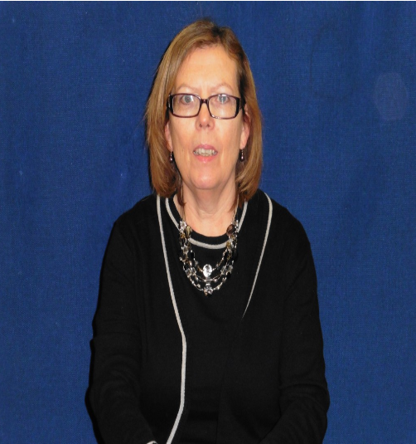

School Governors
The Governing body has representatives from parents,
staff and LEA.
Jane Tranter
Chair of Governors

Slide 24

How you can work in partnership with the school?
Share an interest in your child’s work.
Encourage and praise your child’s efforts.
Listen to your child read their school reading book.
Fill in the parent comment on the reading record.
Check your child’s homework is complete.
Bring in PE kit labelled with name.

Slide 25


