Slide 1

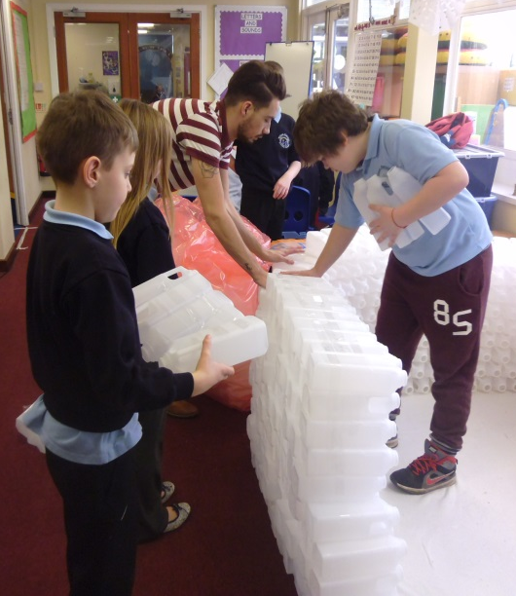
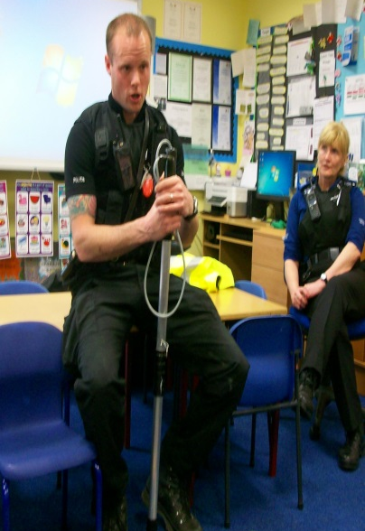
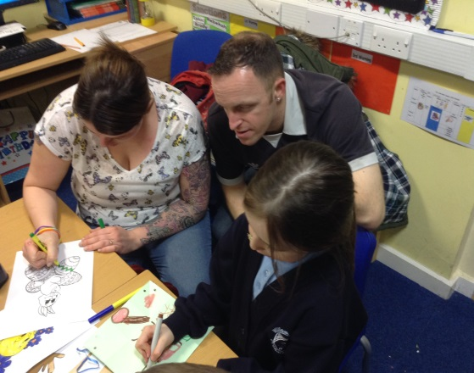
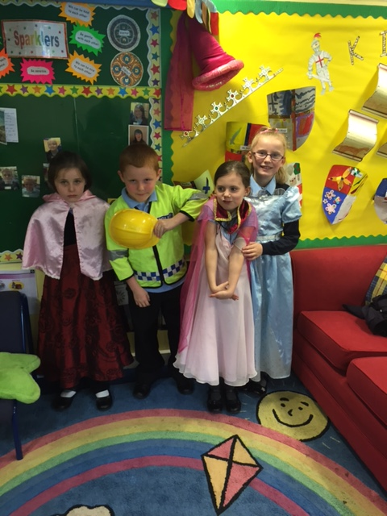
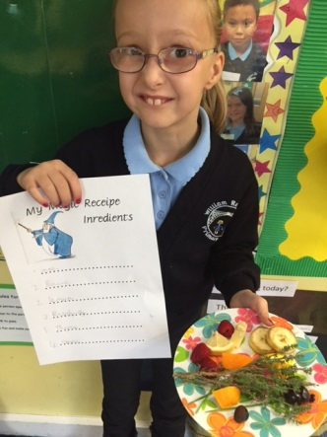
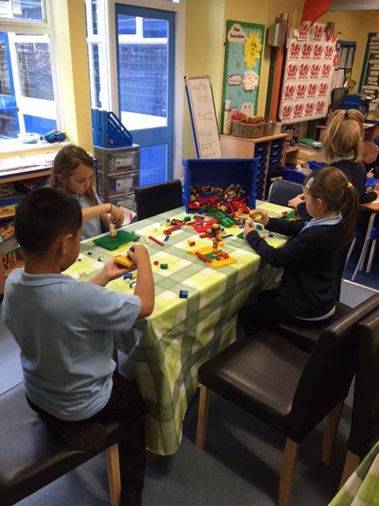
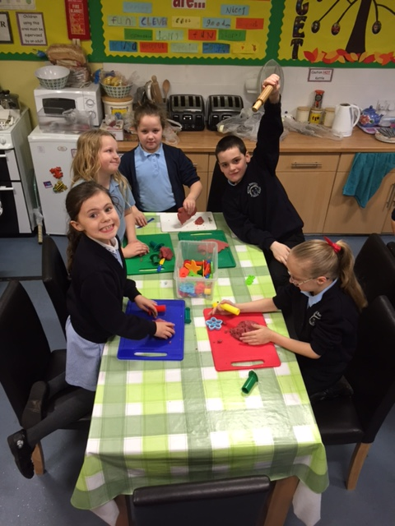

Nurture Group Award
“To be the best we can be”
“An exemplar school with high quality nurturing provision and a nurturing ethos that radiates into every corner of the school.”

Slide 2

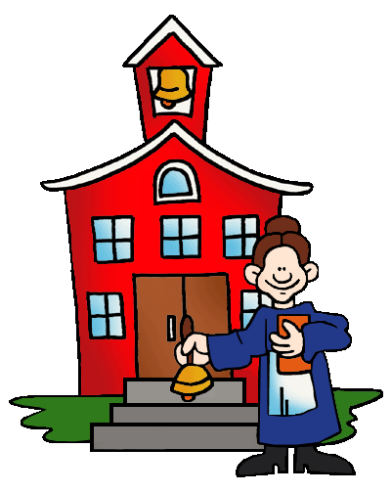


2005 Started
1st Award
2011 2nd Award

Slide 3
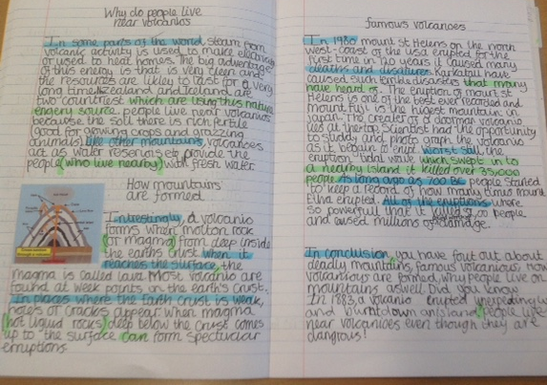
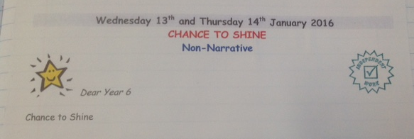
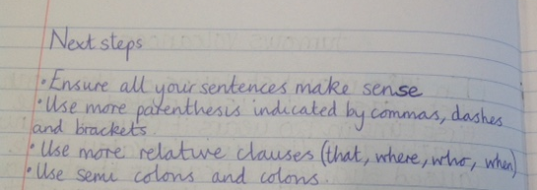

Slide 4
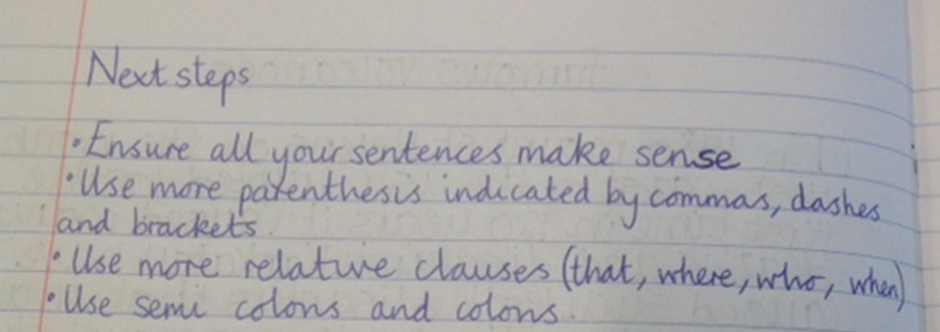
Next steps:
To record on the weekly planning the individual targets for each of the children in ‘Sparklers’.
2.To make sure that with the merger of the two schools that all staff know and understand what the Nurture does and to have a Nurturing approach across the new primary school.

Slide 5



‘To the best we can be.’
2015 3rd Award
1st in Telford & Shropshire
1 out of 3 in whole of country.
2015 – 3rd re-accreditation – what did we have to do?

Slide 6
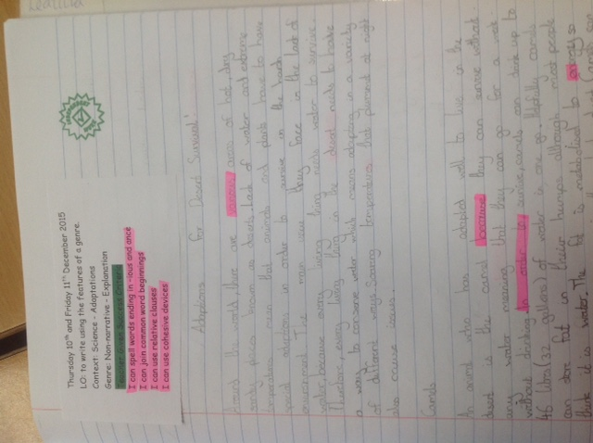
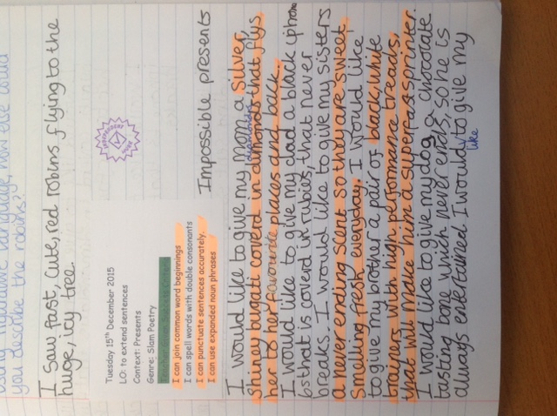
Success criteria (Standards)

Slide 7
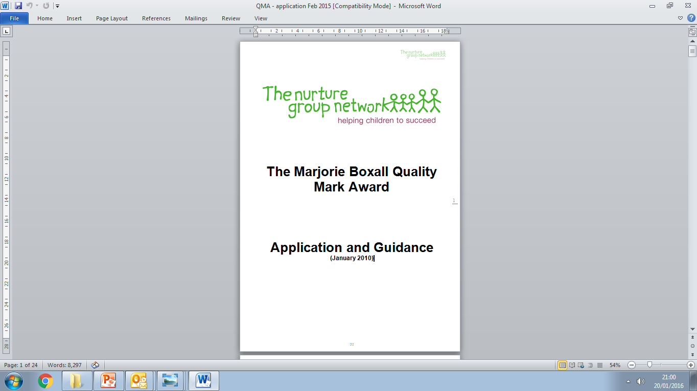


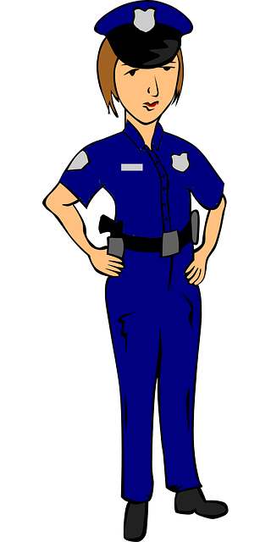
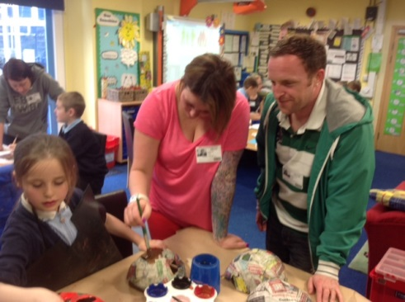

Application form (3 parts)
1. Next steps (2011)
2.
3. History and story behind our Sparklers group.
(File then sent off to Claire)

Slide 8

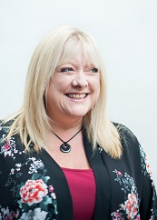
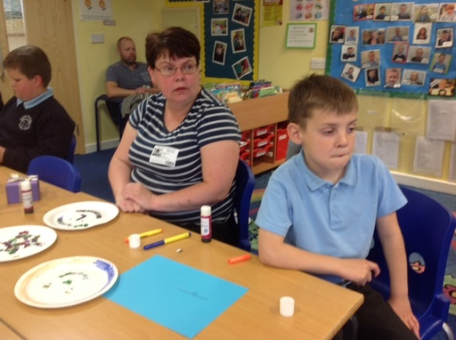
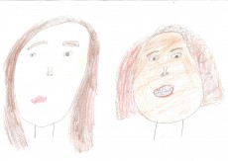
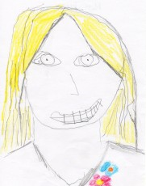
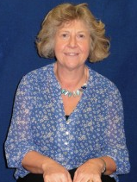
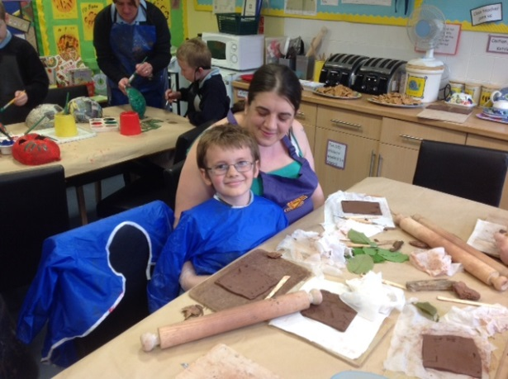
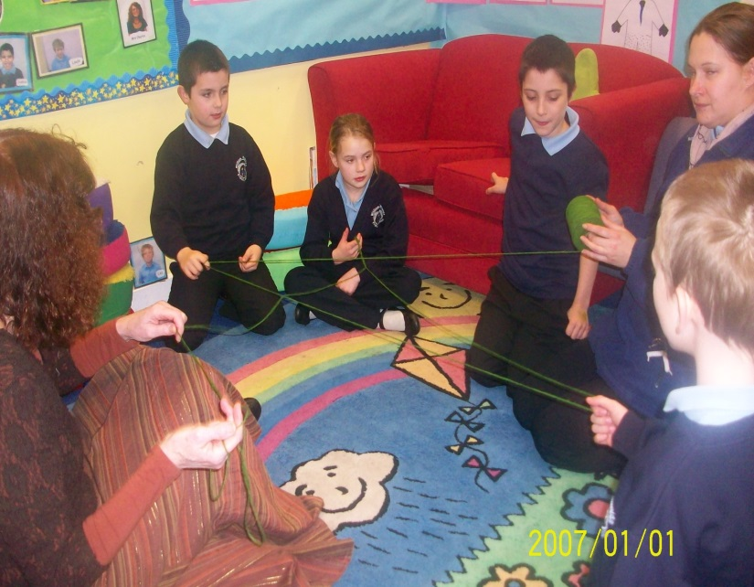
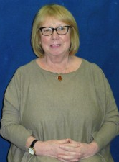
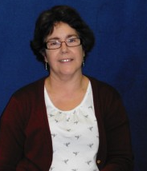
3rd Award
24th June 2015

Slide 9

‘To be the best we can be.’
Staff really care for and understand the needs of the children and parents.
A Nurturing ethos with practices which radiate into every corner of the school
All Nurture group staff are a credit to the school and a the school has an effective culture of social inclusion which in turn promotes positive behaviour within the school.

Slide 10

Next step:
Make sure that as Mrs Clayton retires Mrs Hartwright gets the correct training an support to carry on the fantastic work!

Slide 11
Nurture Group Award
“To be the best we can be”
“An exemplar school with high quality nurturing provision and a nurturing ethos that radiates into every corner of the school.”

